Slide 1
Mood Tracking App
Elizaveta Zagurskih, Olesia Novoselova

Slide 2
01
Problem Statement

Slide 3
Problems
Mental Health Awareness | Helps users become more aware of their emotions and moods, promoting self-awareness and better understanding of their mental health.
Mood Pattern Identification | Enables users to identify patterns in their moods, helping them recognize triggers and correlations between their activities, environment, and mood changes.
Depression Monitoring | Helps users and healthcare providers monitor signs of depression by tracking mood trends over time, facilitating early intervention.
Therapy and Counseling Support | Provides valuable data for therapists and counselors to understand their clients' emotional patterns, making therapy sessions more effective.
Medication and Treatment Tracking | Assists users in tracking the effects of medications or treatments on their mood, providing insights into what works best for them.
Goal Setting and Achievement | Helps users set and achieve personal goals related to improving their mental health and well-being, such as regular exercise, meditation, or social interactions.

Slide 4
02
Features

Slide 5
Features
Users can define their mood once a day.
User can add a text description of the day when adding a note for a particular day and defining mood.
User can see their mood at the particular day when pressing on this day in the calendar on the Home Screen.

Slide 6
Features
Users can choose light or dark theme of the app.
Users can choose English or Russian language.
Users can delete notes of any day, but they can create notes only for today.

Slide 7
Features
Users can change their name in the profile.
Users can change their date of birth in the profile.

Slide 8
03
Architecture Diagram

Slide 9
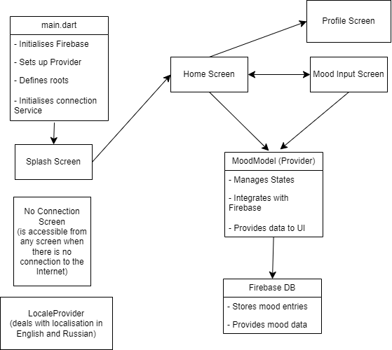

Slide 10
04
Challanges

Slide 11
Challenges and Solutions
Firestore Database Integration
Github Deployment
We needed to specify path to the repository in index.html file in the root of the project.
Database was changed to Firebase Realtime Database. With this choice we lost possibility to store images and videos
Testing Firebase Databse
Custom Paint Integration
Could not solve the problem.
We had two object with Custom Paint logic, and to integrate both objects to the dame screen we created one more class CombinedCustomPainter.

Slide 12
05
App Demonstration

Slide 13
